Slide 1


Computational Intelligence (TC2023)

Slide 2

Unit 3 – Anomaly Detection (1)
Outline
What is Anomaly Detection?
Feature Engineering
Forecasting - ARIMA

Slide 3
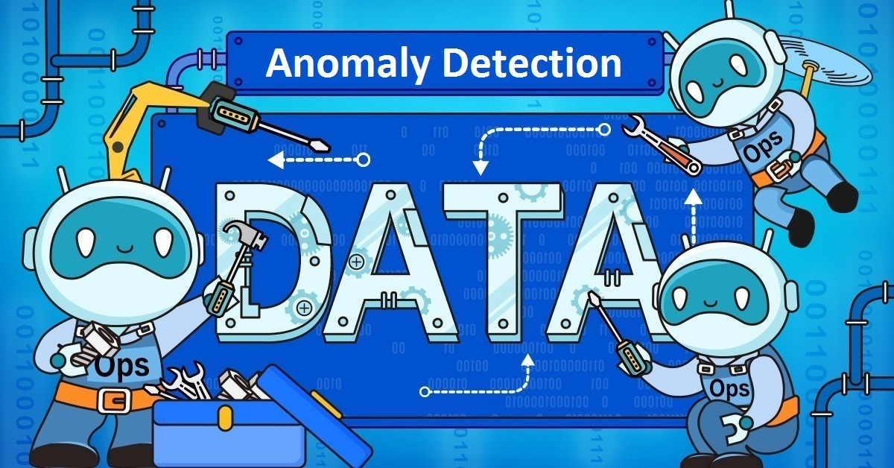
What is Anomaly Detection?

Slide 4
What is Anomaly Detection?
It is the identification of rare items, events or observations which raise suspicions by differing significantly from the majority of the data.
Zimek, Arthur; Schubert, Erich (2017), "Outlier Detection", Encyclopedia of Database Systems, Springer New York, pp. 1–5, doi:10.1007/978-1-4899-7993-3_80719-1, ISBN 9781489979933
novelty detection involves learning a representation of “regular” data using data that does not contain any outliers.
outlier detection: involves learning from data that contains both regular data and outliers.

Slide 5
What is Anomaly Detection?
The study of anomaly detection is closely coupled with the concept of time series analysis because an anomaly is often defined as a deviation from what is normal or expected, given what had been observed in the past.

Slide 6
Anomaly Detection x Supervised Learning
Supervised learning would be especially suited for the problem if you expect future instances of finds (anomality) to look like the examples of anomality you have in your training set (Ex.: Fraud).
Anomaly Detection is the better option when it is hard to find a representative pool of positive examples that is sufficient for the algorithm to get a sense of what positive events are like (Ex.: Zero Day Attack).

Slide 7

Feature Engineering for Anomaly Detection
Host Intrusion Detection
Network Intrusion Detection
Web Application Intrusion Detection (*)

Slide 8

Host Intrusion Detection
When developing an intrusion detection agent for hosts, you will likely need to generate your own metrics and might even want to perform correlations of signals collected from different sources.
The relevance of different metrics varies widely depending on the threat model, but basic system and network-level statistics make for a good starting point.

Slide 9
Examples of some common signals that you can collect:
Running processes
Active/new user accounts
Kernel modules loaded
DNS lookups
Network connections
System scheduler changes
Daemon/background/persistent processes
Startup operations, launchd entries
OS registry databases, .plist files
Temporary file directories
Browser extensions

Slide 10
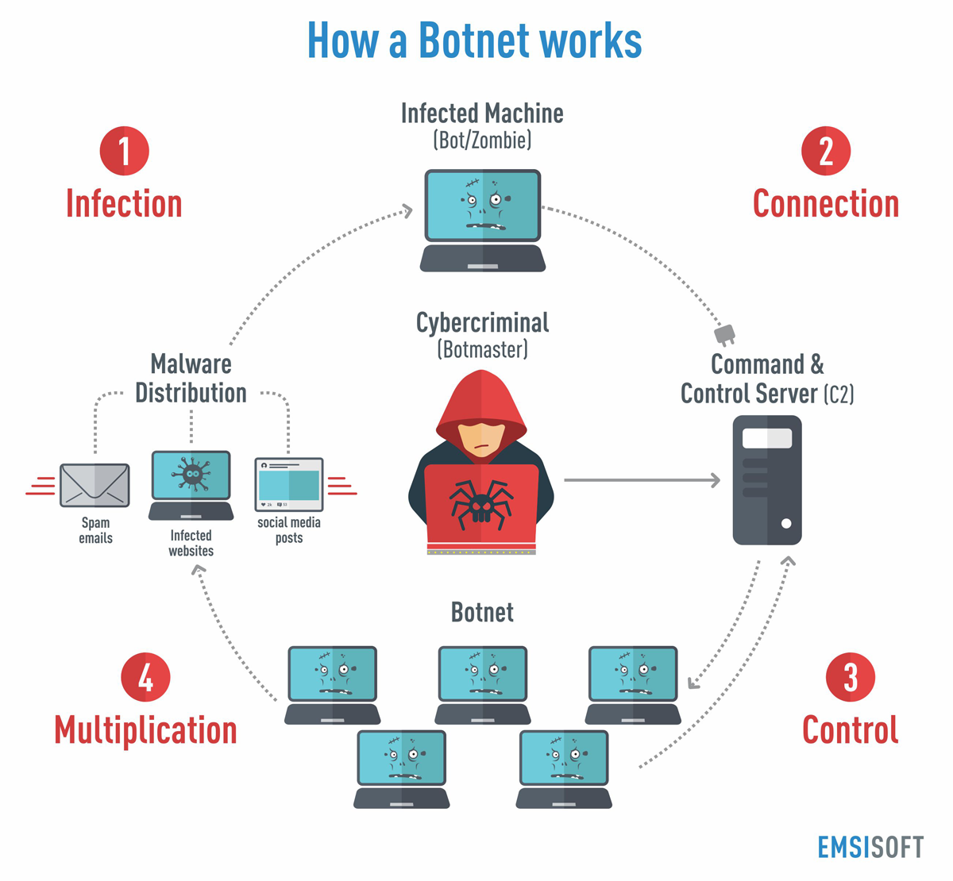
Network Intrusion Detection
A botnet is a logical collection of Internet-connected devices such as computers, smartphones or IoT devices whose security have been breached and control ceded to a third party.
The controller of a botnet can direct the activities of these compromised computers through communication channels formed by standards-based network protocols, such as IRC and Hypertext Transfer Protocol (HTTP).

Slide 11
Network Intrusion Detection
APTs: hackers can remotely access the machines through a vulnerable or misconfigured service, allowing them shell and/or root access.
Adware: communication with external servers is required for downloading unsolicited ad content.
Spyware: results of the covert monitoring are often transmitted over the network to an external receiving server.

Slide 12
Network Intrusion Detection Technologies
Stateful Packet Inspection (SPI):
working at the network and transport layers and examining each network packet’s header and footer without touching the packet context.
This approach maintains state on previous packets received, and hence can associate newly received packets with previously seen packets.
SPI systems can know whether a packet is part of a handshake to establish a new connection, a section of an existing network connection, or an unexpected rogue packet.
Useful in detecting slightly more complex layer 3/4 attacks such as IP spoofing, TCP/IP attacks (such as ARP cache poisoning or SYN flooding), and denial-of-service (DOS) attacks.

Slide 13
Network Intrusion Detection Technologies
Deep packet inspection (DPI) is the process of examining the data encapsulated in network packets, in addition to the headers and footers (application layer).
DPI can collect signals that can help detect spam, malware, intrusions, and subtle anomalies.
Real-time streaming DPI is a challenging computer science problem because of the computational requirements necessary to decrypt, disassemble, and analyze packets going through a network intersection.
One thing you can do is to detect suspicious activity in web applications by inspecting the strings present in the POST body of HTTP requests.

Slide 14

Forecasting

Slide 15
What is Forecasting?
Forecasting is a highly intuitive way of performing anomaly detection: we learn from prior data and make a prediction about the future.
This class of anomaly detection algorithms uses past data to predict current data, and measures how different the currently observed data is from the prediction.

Slide 16
Forecasting – Time Series Descriptors
Trends: Long-term direction of changes in the data, undisturbed by relatively small-scale volatility and perturbations.
Seasons: Periodic repetitions of patterns in the data, typically coinciding with factors closely related to the nature of the data; for example, day-night patterns, summer-winter differences, moon phases.
Cycles: General changes in the data that have pattern similarities but vary in periodicity, e.g., long-term stock market cycles.

Slide 17
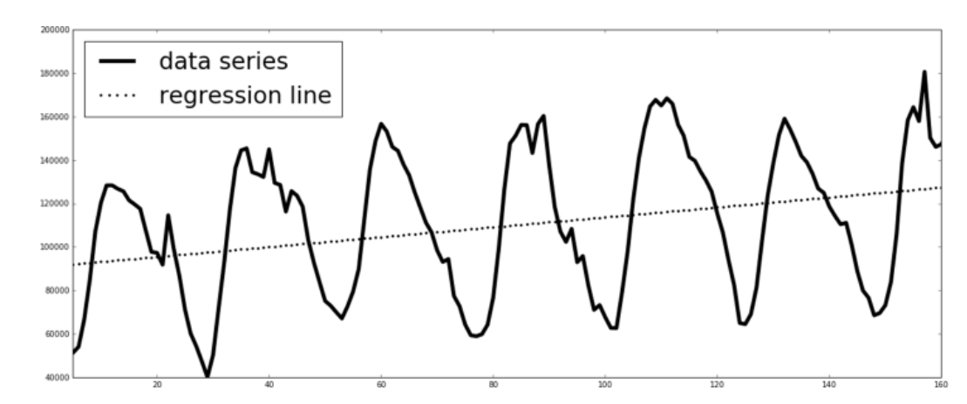
Forecasting – Time Series Descriptors
diurnal season and upward trend

Slide 18
ARIMA (Autoregressive Integrated Moving Average)
Using the ARIMA (autoregressive integrated moving average) family of functions is a powerful and flexible way to perform forecasting on time series.
Autoregressive models are a class of statistical models that have outputs that are linearly dependent on their own previous values in combination with a stochastic factor.
ARIMA uses a distributed lag model in which regressions are used to predict future values based on lagged values (an autoregressive process).
Notes:
Lags = atrasos (ou steps do tempo anterior)

Slide 19
Stationary
Properties do not depend on the time at which the series is observed, implies that the series remains at a constant level over time (having constant statistical properties over time, such as mean and variance).
Time series with trends, or with seasonality, are not stationary.
Time series with cyclic behavior (but with no trend or seasonality) is stationary. This is because the cycles are not of a fixed length, so before we observe the series, we cannot be sure where the peaks and troughs of the cycles will be.

Slide 20
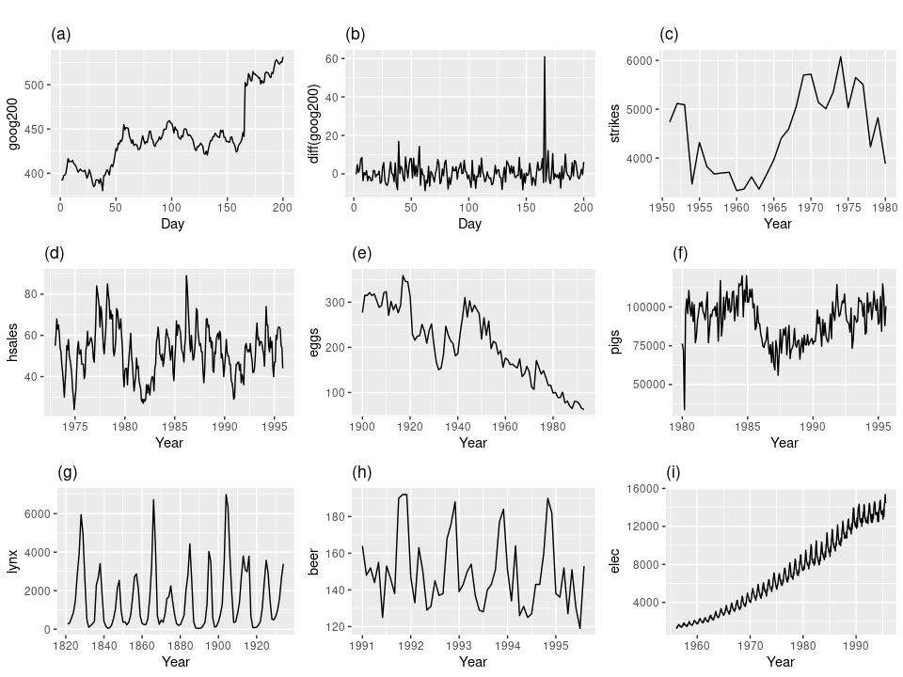

Which of these series are stationary?
No trends or seasons

Slide 21
Autocorrelation
Autocorrelations are numerical values that indicate how a data series is related to itself over time.
More precisely, it measures how strongly data values at a specified number of periods apart (lag) are correlated to each other over time.
"lag“: number of periods apart.
For example, an autocorrelation at lag 1 measures how values 1 period apart are correlated to one another throughout the series.

Slide 22
ARIMA Model
An ARIMA model is characterized by 3 terms: p, d, q:
p is the order of the AR term
q is the order of the MA term
d is the number of differencing required to make the time series stationary

Slide 23
AR term
Auto Regressive (AR) in ARIMA means it is a linear regression model that uses its own lags as predictors.
Linear regression models, as you know, work best when the predictors are not correlated and are independent of each other.
ε(t)
Y(t) = time series prediction
β(1) = the autoregressive parameter of order 1
Y(t-1) = the time series lagged 1 period
ε(t) = the error term of the model

Slide 24
MR term
Rather than using past values of the forecast variable in a regression, a moving average model uses past forecast errors in a regression-like model.
Moving average parameters relate what happens in period t only to the random errors that occurred in past time periods.

Slide 25
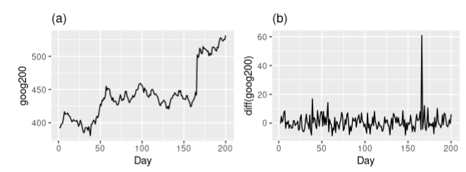
Differencing
How to make a series stationary?
The most common approach is to difference it.
That is, subtract the previous value from the current value.
The value of d, therefore, is the minimum number of differencing needed to make the series stationary.
Google stock price was non-stationary in panel (a), but the daily changes were stationary in panel (b). This shows one way to make a non-stationary time series stationary — compute the differences between consecutive observations.

Slide 26
ARIMA Model
An ARIMA model is characterized by 3 terms: p, d, q:
p is the order of the AR term
q is the order of the MA term
d is the number of differencing required to make the time series stationary
Predicted Y_{t} =
Constant
+ Linear combination Lags of Y
+ Linear Combination of Lagged forecast errors
Notes:
+ Linear combination Lags of Y (upto p lags) + Linear Combination of Lagged forecast errors (upto q lags)

Slide 27
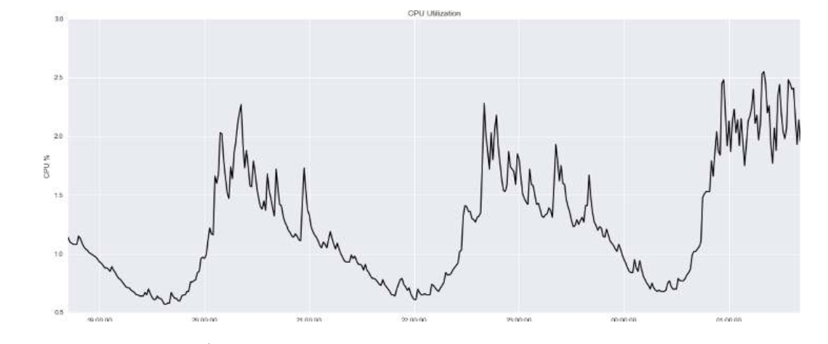
Example – CPU Utilization
Looks stationary
Perform anomaly detection on per-minute metrics of a host’s CPU utilization.
y-axis: the percentage CPU utilization
x-axis: time.
No trends or seasons

Slide 28
Example – CPU Utilization
PyFlux: time series library for Python
https://www.lfd.uci.edu/~gohlke/pythonlibs/#pyflux
conda install numpy pandas scipy patsy matplotlib seaborn pandas-datareader jupyter
pip install numdifftools
pip install pyflux-0.4.17-cp37-cp37m-win_amd64.whl
Check Python version

Slide 29
Example – CPU Utilization
ARIMA forecasting algorithm:
autoregressive (AR) order 11
moving average (MA) order 11
differencing order of 0 (because the series looks stationary)

Slide 30
import pandas as pd import pyflux as pf from datetime import datetime # Read in the training and testing dataset files data_train_a = pd.read_csv('resources/cpu-train-a.csv', parse_dates=[0], infer_datetime_format=True) data_test_a = pd.read_csv('resources/cpu-test-a.csv', parse_dates=[0], infer_datetime_format=True) # Define the model model_a = pf.ARIMA(data=data_train_a, ar=11, ma=11, integ=0, target='cpu') # Estimate latent variables for the model using the # Metropolis-Hastings algorithm as the inference method x = model_a.fit("M-H") # Plot the fit of the ARIMA model against the data model_a.plot_fit()

Slide 31
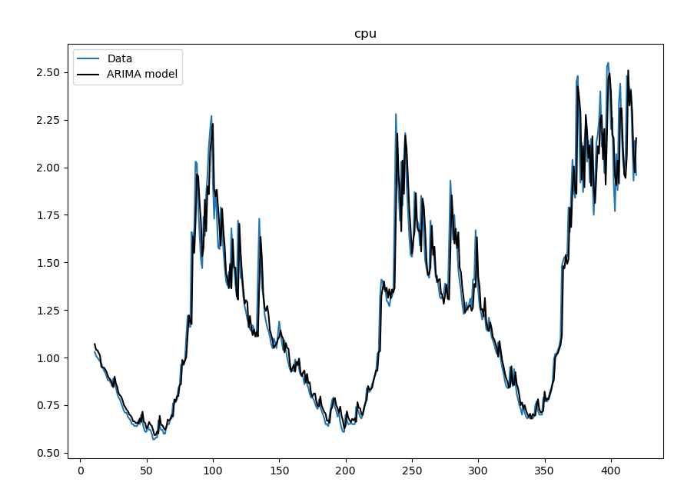

Slide 32
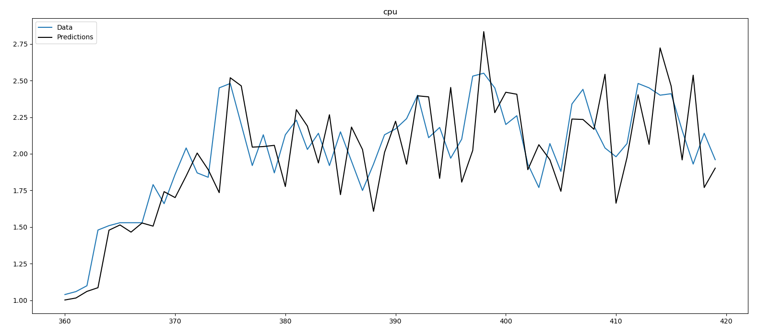
model_a.plot_predict_is(h=60, figsize=(20,8))
We can do an in-sample test on the last 60 data points of the training data.
The in-sample test is a validation step that treats the last subsection of the series as unknown and performs forecasting for those time steps.

Slide 33
Unit 3 – Anomaly Detection (1)
Outline
What is Anomaly Detection?
Feature Engineering
Forecasting - ARIMA

Slide 34
Computational Intelligence (TC2023)

